Slide 1

Mastering .NET Source Generators
Vladislav Antonyuk
Notes:
Hello everyone! Today we will talk about .NET Source Generators

Slide 2




Speaker
Vladislav Antonyuk
Senior .NET Developer
Microsoft MVP
.NET MAUI Community Toolkit Core Maintainer
https://vladislavantonyuk.github.io | https://www.linkedin.com/in/vladislav-antonyuk/ | https://youtube.com/@VladislavAntonyuk
Notes:
A few words about me. I am a Senior .NET Developer at DataArt, a Microsoft MVP, many may already know me from the .NET MAUI Community as I am one of the .NET MAUI Community Toolkit Core Maintainers. You can also find interesting videos and publications on my website, LinkedIn and YouTube.

Slide 3
Source Generators
Source Generators is a Roslyn compiler feature introduced in .NET 5.
Source generators perform code generation at compile time, providing the ability to add source code to your project automatically.
Compilation Runs
Source Generator Step of Compilation
Generated Source Code added as a Input to Compilation
Compilation Resumes
Source Generator
Analyze Source Code
Generate New Source Code
Notes:
So let's talk about Source generators. Source generators were introduced with .NET 5 as a feature of the Roslyn compiler. Their main task, as can be seen from the diagram, is the analysis and generation of code that occurs at the compilation stage, which makes it possible to add source code to the project automatically.

Slide 4
Common Scenarios
1
2
3
Runtime Reflection
Juggling MSBuild Tasks
Intermediate Language (IL) Weaving
Notes:
Today, there are three general approaches to inspecting user code and generating code based on this analysis: runtime reflection, MSBuild task juggling (when the same MSBuild task can be called multiple times), and IL weaving (when direct modification of IL code is required) . Source Generators can improve each approach.

Slide 5
Where can I use them?
Dependency Injection (IoC Container)
Mappers
Enums
CSharp Source Generators
Link
Notes:
With the emergence of Source generators, they were most often created in Dependency Injection tasks (for automatic generation, instead of assembly scanning), for automating mappers (for automatic mapping of properties), in Enum (when a static class with all possible methods was generated) and many others.

Slide 6
Demo
Notes:
Let's consider the work of source generators using specific examples

Slide 7
Cacheability is the Most Important Factor
[EnumExtensions] public enum MyEnum
{
First Second, }
[EnumExtensions] public enum MyEnum
{
First Second, }
Public class Other {}
3. The user edits their code, adding an unrelated class
[EnumExtensions] public enum MyEnum
{
First Second, Third }
Public class Other {}
7. The user edits their code, adding a new enum value
ForAtributeWithMetadataName()
1. On the first execution, all of the stages execute, and the intermediate results are cached
ForAtributeWithMetadataName()
4. The first stage executes, but it produces the same outputs as the first run
ForAtributeWithMetadataName()
8. The first stage executes, but this time produces different outputs
enumDetails
enumDetails
enumDetails
Select()
Select()
5. As the inputs are the same, the next stage is skipped, as it can use the cached outputs
Select()
9. As the input is different, the next stage must execute and produces different output
valuesToGenerate
valuesToGenerate
valuesToGenerate
RegisterSourceOutput()
2. New sources are generated and added to the output
RegisterSourceOutput()
6. Similarly, generation
can be skipped because the outputs are the same
RegisterSourceOutput()
Generated Source
Generated Source
Generated Source

Slide 8
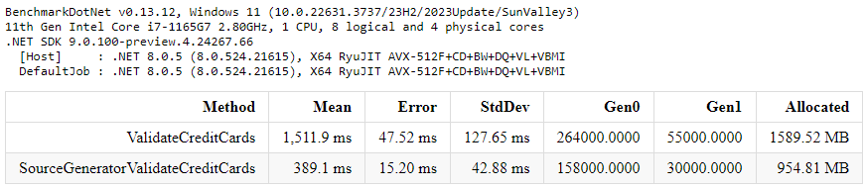
Benchmark Results

Slide 9
Source Generators Alternatives
1
2
3
T4
Scripty
Fody
<#@ template hostspecific="false" language="C#" #>
<#@ output extension=".txt" #>
<#int top = 10;
for (int i = 0; i<=top; i++)
{ #>
The square of <#= i #> is <#= i*i #>
<# } #>
//TestScript.csx
#load "TestCSharpFile.csx.cs"
var sc = new ScriptContainer(Context);
await sc.OutputProjectStructure();
<Weavers>
<NullGuard IncludeDebugAssert="false" />
<PropertyChanged/>
</Weavers>
Notes:
There are quite a few alternatives to Source generators, but the main ones that most people know about are T4, Scripty and Fody. For myself, I singled out the following advantages of Source generators.
1) no need to learn new syntax 2) Source generators are part of the Compile Pipeline, so they work wherever the compiler works. 3) Do not allow to rewrite the code. The only significant drawback, in my opinion, is the limitation in the generation of file types. Source generators only allow you to generate C#, F# or Visual Basic files.

Slide 10
References
R1
https://learn.microsoft.com/en-us/dotnet/csharp/roslyn-sdk/source-generators-overview
R2
https://andrewlock.net/series/creating-a-source-generator/
R3
https://github.com/amis92/csharp-source-generators
R4
https://github.com/VladislavAntonyuk/SourceGeneratorsDemo
Notes:
Useful links and samples can be found on these websites

Slide 11
Thank
You!
Notes:
This is the end of my presentation, thank you for your attention.

